Slide 1

Diamond Inventory & Sales Management System

Slide 2
Abstract
The Diamond Inventory and Sales Management System is a comprehensive application designed to streamline the process of managing diamond stock, sales transactions, and related customer and financial information. This system uses a MySQL database for managing critical data related to diamonds, customers, sales, transactions, and bonuses. It enables diamond merchants, jewelry retailers, and manufacturers to track the entire lifecycle of diamond products from procurement to sales, ensuring efficient inventory management and accurate sales records.
Key features of the system include:
Diamond Inventory Management: The system stores detailed information about each diamond in inventory, including type, weight, quality, price, and stock levels.
Sales and Transaction Tracking: The system records sales transactions, linking customer details, purchased diamonds, and transaction amounts, providing a clear view of the sales pipeline.
Customer Relationship Management (CRM): It manages customer data, including contact information and purchase history, helping sales teams offer personalized service.
Bonus and Commission Calculation: It automatically calculates and tracks bonuses or commissions for sales representatives based on sales performance and predefined rules.
Reporting and Analytics: The system generates reports on sales performance, inventory levels, customer purchases, and overall business trends, aiding decision-making for business growth.

Slide 3
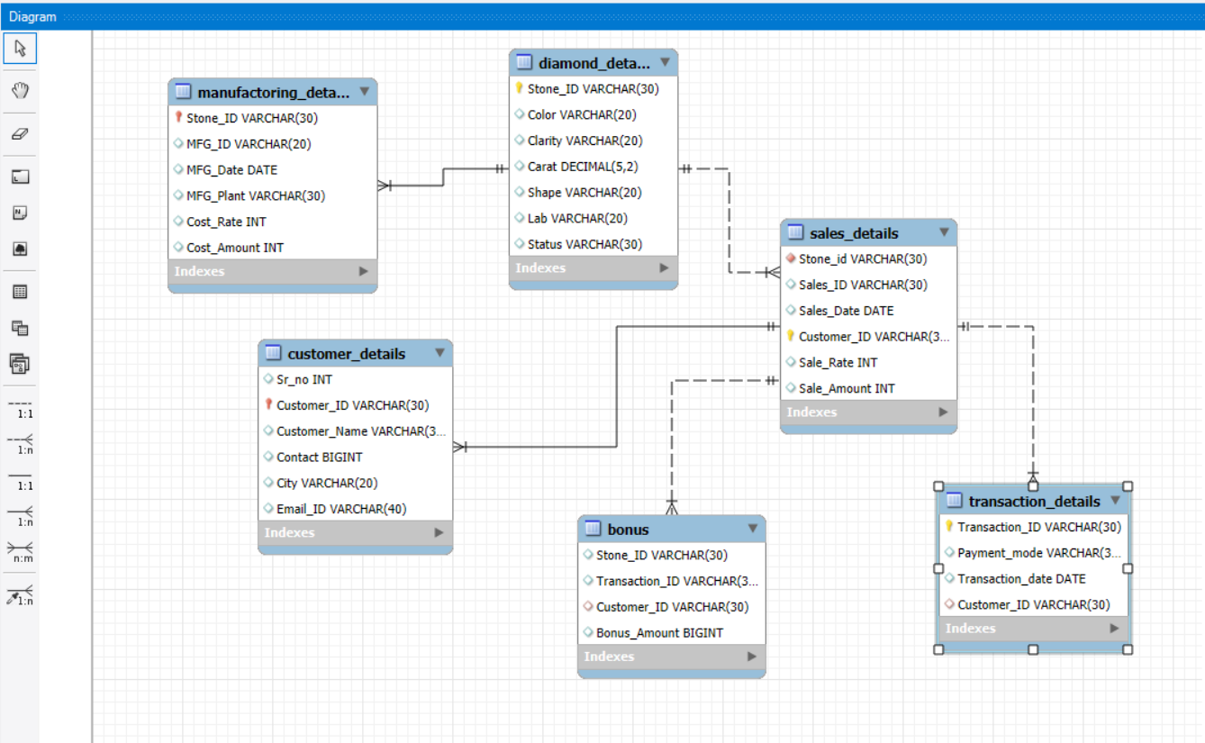
ER-Diagram

Slide 4
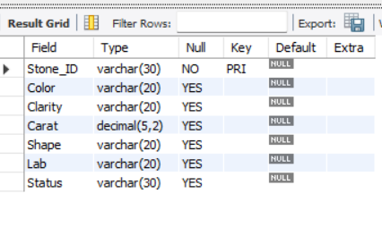
Structure Of Table
Diamond_details Table
The diamond details table stores important information about the diamonds in inventory.
Syntax;
Create table Diamond_details
(Stone_ID varchar(30) primary key,Color varchar(20),Clarity varchar(20),Carat decimal(5,2),Shape varchar(20),Lab varchar(20),Status varchar(30));
desc diamond_details;

Slide 5
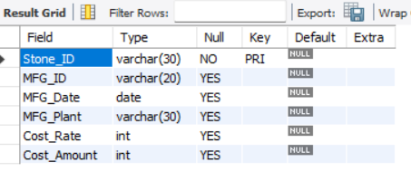
Structure Of Table
Manufactoring_details Table
The Manufactoring details table stores information related to the production like mfg plant , date and cost for making it final product.
Syntax:
create table Manufactoring_details
(Stone_ID varchar(30) primary key,MFG_ID varchar(20),MFG_Date date,MFG_Plant varchar(30),Cost_Rate int,Cost_Amount int);
desc manufactoring_details;

Slide 6
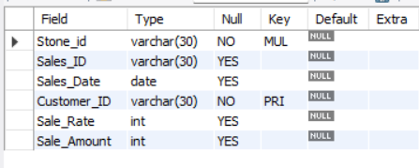
Structure Of Table
Sales_details Table
Sales details table in a Diamond Inventory and Sales Management System is used to store information about the sales transactions related to diamonds. This table typically records the details of each sale, including the diamond sold, the customer who made the purchase, the sales amount, and other relevant transaction data.
Syntax:
create table Sales_details
(Stone_ID varchar(30) primary key,Sales_ID varchar(30),Sales_Date date,Customer_ID varchar(30),Sale_Rate int,Sale_Amount int);
desc Sales_details;
alter table Sales_details drop primary key;
ALTER TABLE Sales_details ADD PRIMARY KEY (Customer_ID);

Slide 7
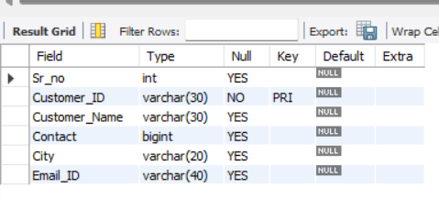
Structure Of Table
Customer_details Table
Customer details table stores information related to customers in a Diamond Inventory and Sales Management System. This table is crucial for maintaining customer records and helps in tracking customer behavior, preferences, and purchase history. The data in this table can be used for customer relationship management (CRM), marketing strategies, and analyzing customer buying patterns.
Syntax:
create table Customer_details
(Sr_no int,Customer_ID varchar(30) primary key,Customer_Name varchar(30),Contact bigint,City varchar(20),Email_ID varchar(40));
desc customer_details;

Slide 8
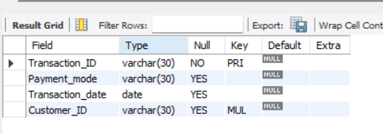
Structure Of Table
Transaction_details Table
Ansaction details table in a Diamond Inventory and Sales Management System is used to store information related to financial transactions that occur as part of the sales process. It tracks payments, refunds, and other transaction-related events that help manage the financial aspects of diamond sales.
Syntax:
create table Transaction_details
(Transaction_ID varchar(30) primary key,Payment_mode varchar(30),Transaction_date date,Customer_ID varchar(30));
desc transaction_details;

Slide 9
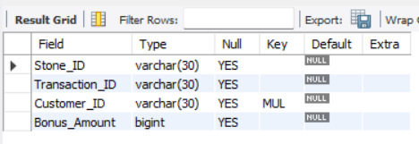
Structure Of Table
Bonus Table
Bonus table in a Diamond Inventory and Sales Management System is used to store information about bonuses or rewards given to customers.
Syntax:
create table Bonus(Stone_ID varchar(30),Transaction_ID varchar(30),Customer_ID varchar(30),Bonus_Amount bigint);
desc bonus;

Slide 10
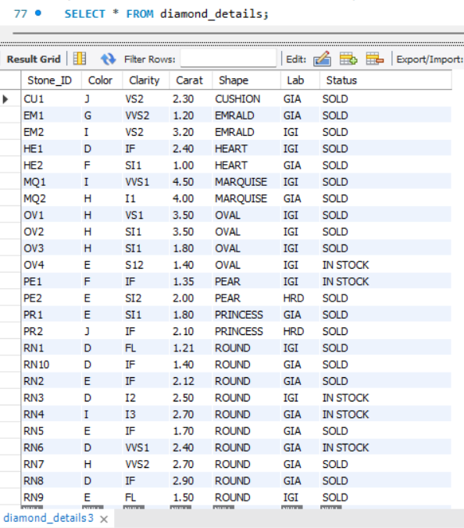
Content Of Table

Slide 11
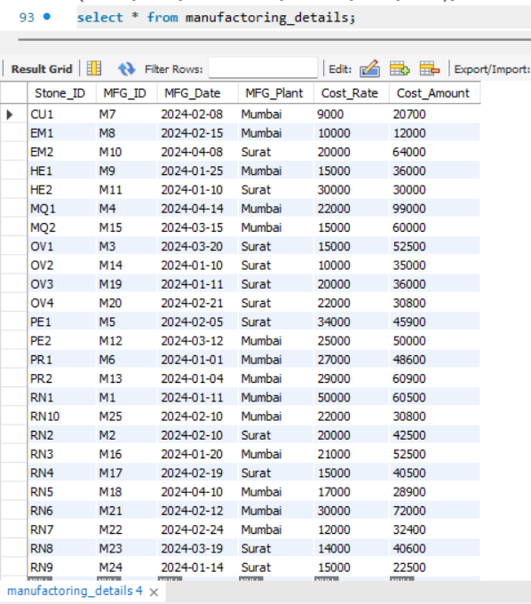
Content Of Table

Slide 12
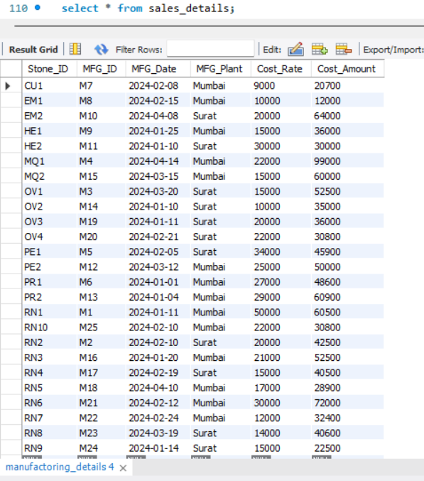
Content Of Table

Slide 13
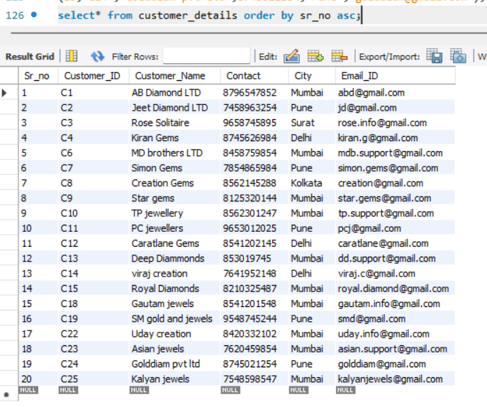
Content Of Table

Slide 14
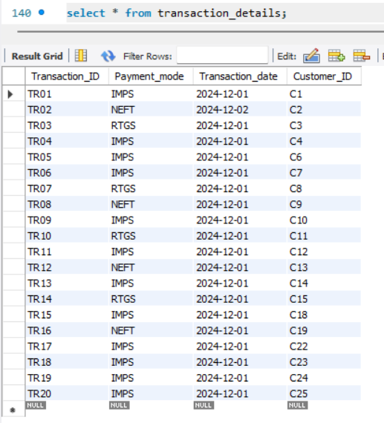
Content Of Table

Slide 15
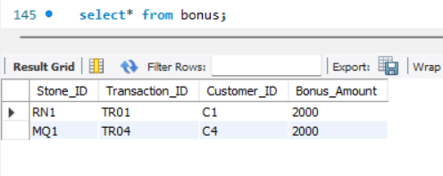
Content Of Table

Slide 16

Sub-Queries

Slide 17

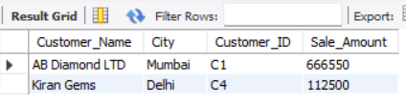
DISPLAY THE CUSTOMER NAME AND SALE AMOUNT WHOSE SALE AMOUNT IS GREATER THAN AVERAGE OF TOTAL SALE.
SYNTAX:
Select customer_details.Customer_Name,customer_details.City,customer_details.Customer_ID,sales_details.Sale_Amount from customer_details join sales_details on customer_details.Customer_ID=sales_details.Customer_ID where sale_amount>(select avg(sales_details.Sale_Amount) from sales_details);

Slide 18
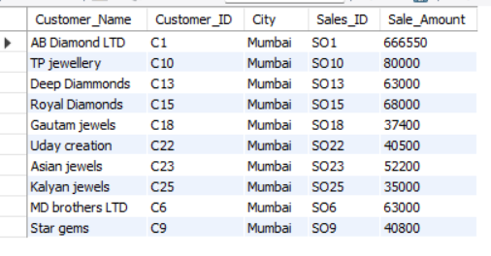
DISPLAY THE WHICH CITY HAS MOST SALE.
SYNTAX:
select customer_details.Customer_Name,customer_details.Customer_ID,customer_details.City,sales_details.Sales_ID,sales_details.Sale_Amount from customer_details join sales_details on customer_details.Customer_ID=sales_details.Customer_ID where city=(select customer_details.City from customer_details join sales_details on customer_details.Customer_ID=sales_details.Customer_IDgroup by city order by count(Sales_ID) desc limit 1);

Slide 19
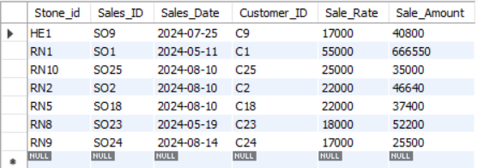
DISPLAY THE BEST QUALITY DIAMONDS WITH SALES DETAILS.
SYNTAX:
select * from sales_details where Stone_id in(select Stone_id from diamond_details where Color in ("D","E","F") and Clarity in ("fl","if","vvs1","vvs2"));

Slide 20
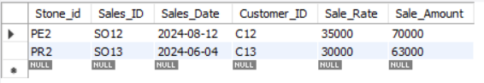
DISPLAY THE SALE DETAILS OF DIAMONDS WHICH IS HRD CERTIFIED.
SYNTAX:
select * from sales_details where Stone_id=any(select Stone_id from diamond_details where lab="HRD");

Slide 21
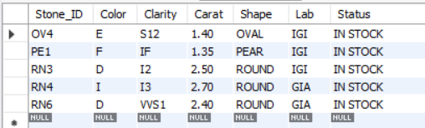
DISPLAY THE DIAMOND DETAILS WHICH IS AVAILABLE IN STOCK.
SYNTAX:
select * from diamond_details where Stone_ID not in(select Stone_ID from sales_details);

Slide 22
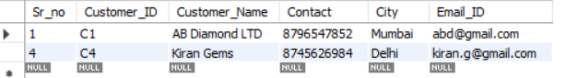
DISPLAY THE CUSTOMER DETAILS WHO ARE ELIGIBLE FOR BONUS ON BASIS OF MAXIMUM AMOUNT OF SALE.
SYNTAX:
select * from customer_details where Customer_ID in(select Customer_ID from bonus);

Slide 23
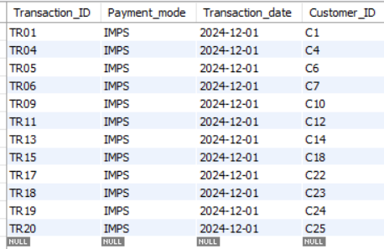
DISPLAY THE TRANSACTION DETAIL OF PAYMENT MODE WHICH IS MOST FREQUENTLY USE BY CUSTOMER.
SYNTAX:
select * from transaction_details where Payment_mode =(select Payment_mode from transaction_details group by Payment_mode order by count(Payment_mode) desc limit 1 );

Slide 24
JOINS

Slide 25
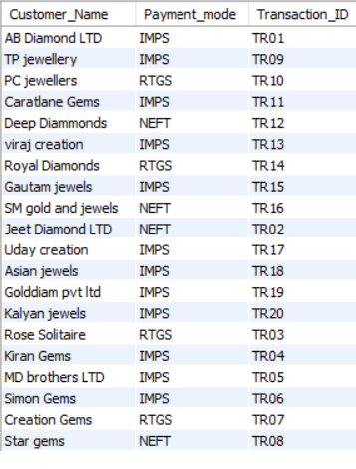
DISPLAY THE CUSTOMER NAME, PAYMENT MODE, TRANSACTION ID OF ALL SOLD DIAMONDS.
SYNTAX:
select customer_details.Customer_Name,transaction_details.Payment_mode, transaction_details.Transaction_ID from customer_details inner join transaction_details on customer_details.Customer_ID=transaction_details.Customer_ID;

Slide 26
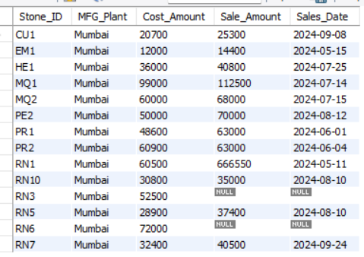
DISPLAY THE DIAMONDS DETAILS WHICH IS MANUFACTORED IN MUMBAI PLANT.
SYNTAX:
select manufactoring_details.Stone_ID,manufactoring_details.MFG_Plant, manufactoring_details.Cost_Amount,sales_details.Sale_Amount, sales_details.Sales_Date from manufactoring_details left join sales_details on manufactoring_details.Stone_ID=sales_details.Stone_idwhere MFG_Plant="Mumbai";

Slide 27
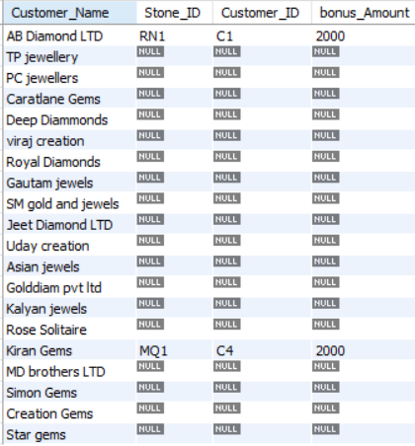
DISPLAY THE CUSTOMER DETAILS WHO ARE GETTING BONUS AMOUNT ON THE BASIS OF MAX SALES AMOUNT.
SYNTAX:
select customer_details.Customer_Name,bonus.Stone_ID,bonus.Customer_ID, bonus.bonus_Amount from bonusright join customer_details on customer_details.Customer_ID=bonus.customer_ID;

Slide 28
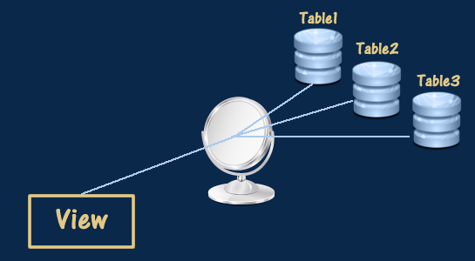
VIEWS

Slide 29
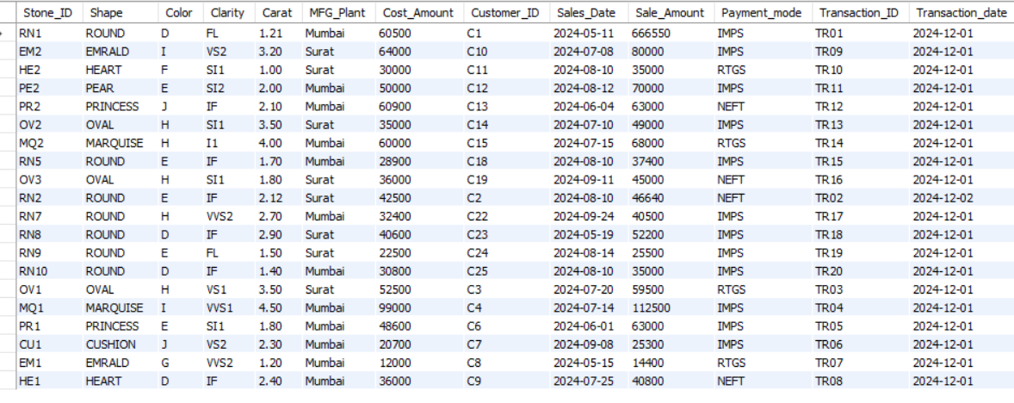
CREATING VIEW AS DIAMOND HISTORY.
SYNTAX:
create view Diamond_history as select diamond_details.Stone_ID,diamond_details.Shape,diamond_details.Color,diamond_details.Clarity,diamond_details.Carat,manufactoring_details.MFG_Plant,manufactoring_details.Cost_Amount,sales_details.Customer_ID, sales_details.Sales_Date,sales_details.Sale_Amount,transaction_details.Payment_mode,transaction_details.Transaction_ID,transaction_details.Transaction_date from diamond_details join manufactoring_details on diamond_details.Stone_ID=manufactoring_details.Stone_IDjoin sales_details on manufactoring_details.Stone_ID=sales_details.Stone_idjoin transaction_details on sales_details.Customer_ID=transaction_details.Customer_ID;

Slide 30
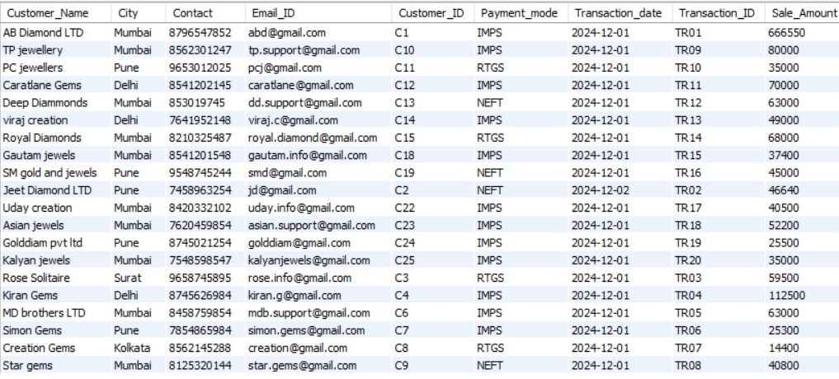
CREATING VIEW AS TRANSACTION HISTORY.
SYNTAX:
create view Transaction_history asselect customer_details.Customer_Name, customer_dtails.City,customer_details.Contact,customer_details.Email_ID,transaction_details. Customer_ID,transaction_details.Payment_mode, transaction_details.Transaction_date,transaction_details.Transaction_ID,sales_details.Sale_Amount from customer_details join transaction_details on customer_details.Customer_ID=transaction_details.Customer_ID join sales_details on sales_details.Customer_ID=transaction_details.Customer_ID;

Slide 31

PREPARED BY-
RUSHIKESH PAWAR
IT VEDANT
T331 DATA SCIENCE & ANALYTICS

